Slide 1




Chapter 20: The Written Research Report

Slide 2



Happy Halloween
Take some candies

Slide 3
Learning Objectives
Discuss three writing standards that a report should meet if it is to communicate effectively with readers
Outline the main elements that make up a standard research report
Explain the kind of info contained in the executive summary

Slide 4
The Written Research Report
Research reports are evaluated based on one fundamental issue: How well do they communicate with the reader?
Near-perfect research can get lost in the clutter of a poorly written report

Slide 5
The Paradox of Completeness
Completeness: The degree to which the report provides all the info readers need in langue they understand
A written report must be complete… without being too complete. The trick is to determine what really matters and what ought to be shifted to an appendix or left out entirely (caution).
Notes:
Strategic omission.

Slide 6
Accuracy
The degree to which the reasoning in the report is logical and the information correct

Slide 7
Examples of Inaccuracy
Inaccuracy | Example
Simple Errors in Addition or Subtraction | “In the US, 14% of the population ahs an elementary school education or less, 51% has attended or graduated form high school, and 16 has attended college.”
Confusion between percentages and Percentage Points | “The company’s profits as a percentage of sales were 6% in 1997 and 8% in 20002. Therefore, they increased only 2% in five years.”
Inaccuracy Caused by Grammatical Errors | “The reduction in the government’s price supports for diary products has reduced farm income from $600 million to $800 million per year.”
Confused Terminology Resulting in Faulty Conclusions | “The Jones’ household annual income increased from $15,000 in 1976 to $45,000 in 2006, thereby tripling the family’s purchasing power.”

Slide 8

Clarity
The degree to which the phrasing in the report is precise

Slide 9

How to Achieve Clarity
Carefully organize your report
Write in short sentences and paragraphs
Write… rewrite… and rewrite again
Shorten the report until every word has purpose

Slide 10
Written Research Report Outline
Completeness must be balanced against Clarity

Slide 11
Written Research Report Outline
Exhibit 20.2 Written Research Report Outline
Title page
Table of contents
Executive summary
Introduction
Method
Results
Research Findings
Limitations
Conclusions and recommendations
Appendices
Copies of data collection forms
Data collection forms with univariate results
Codebook
Technical appendix (if necessary)
Exhibits not included in the body (if necessary)
Data file for archival storage
Bibliography

Slide 12
Executive Summary
The executive summary is the most important part of the report
Think about what you would most want to communicate about he project if you only had 60 seconds to do so.
Introduction
Results
Conclusions
Recommendations

Slide 13
Introduction
The introduction sets up the project by providing background for the project and specifying the decision problem and research problem(s)

Slide 14
Method
This section is important – and difficult to handle well. You need to provide enough detail so that readers know how you conducted the research but not so much detail that they get lost and lose sight of the bigger story you are telling in the report.

Slide 15
Results
The results section should be organized to provide answers to the research problem(s) that motivated the project
Because no projects are perfect, be sure to include a limitation section. This often adds credibility to the overall project.
Tables and figures are encouraged IF they help communicate answers to research problems. Place them in the results section to illustrate the key findings.
All other exhibits should probably be placed in an appendix and referenced in the text as needed.

Slide 16
Conclusions and Recommendations
There should be a conclusion for each of the research problems that motivated the study
Researchers' recommendations about what to do next based on the research findings follow the conclusions

Slide 17
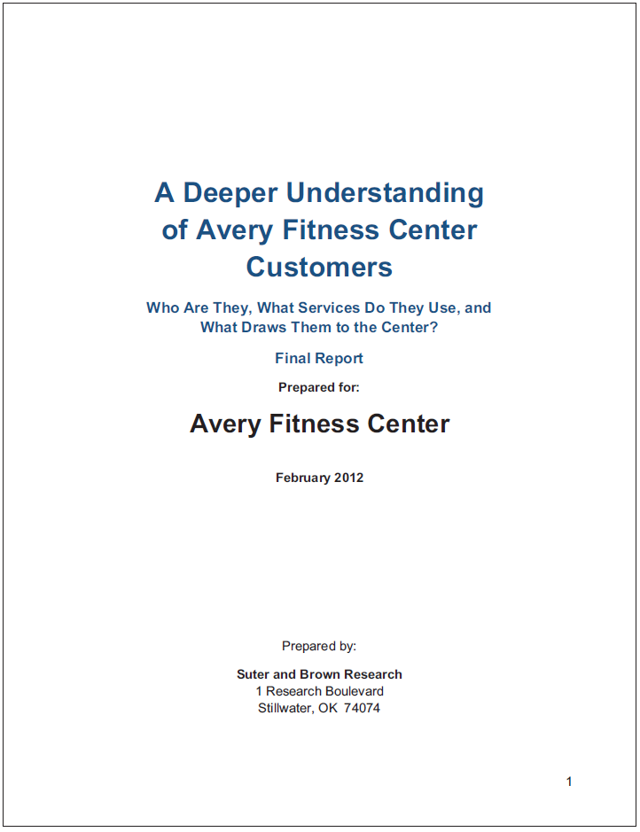
Appendices
The research report provides an archive of the project. Here are some things that should be included:
Copies of data collection forms
Univariate results and/or data tables (often placed on the data collection form)
Codebook
Technical appendix or any additional exhibits not included in results (if needed)
Data file
Bibliography

Slide 18
5-min Snippet – Conjoint Analysis

